Slide 1
Tecnologias de Rede Sem Fio

Slide 2
Tópicos Abordados
Fundamentos de uma Rede Sem Fio
Componentes
Topologia
Problemas com a Rede
Tecnologias de Rede Local Sem Fio
Benefícios
Notes:
This Section explains the fundamentals of a wireless network, compares other wireless technologies and explains the benefits of a wireless network.
This section contains 6 slides.

Slide 3
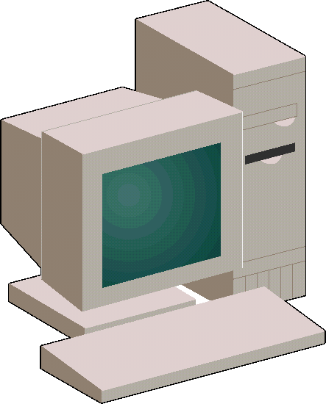
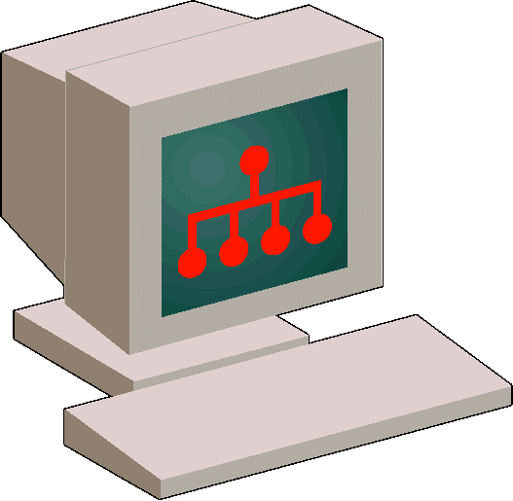
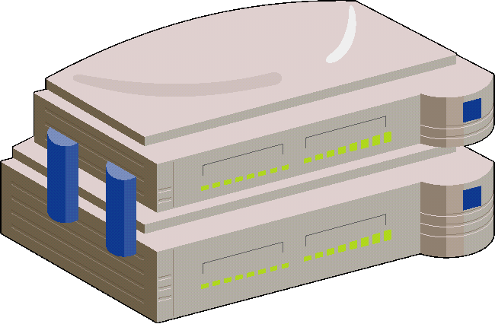

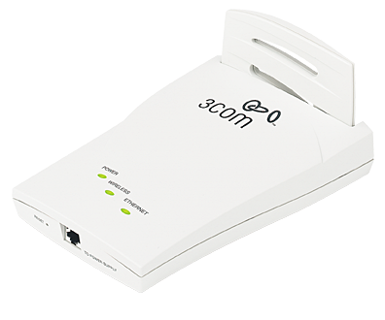
O que é uma Rede Sem Fio?
Uma rede implementada sem a utilização de cabos instalados sobre paredes para interligar estações
  Tipicamente, uma extensão ou uma alternativa a rede local cabeada
  Todos os serviços e capacidades são preservados
Utiliza tecnologia de rádio frequência para transmitir e receber dados
Uma rede local sem fio combina conectividade de dados com usuários móveis
Normalmente restrito a um edifício ou terreno
Notes:
Wireless LANs can be simple or complex.
At its most basic, two PCs equipped with wireless adapter cards can set up an independent network whenever they are within range of one another. This is called a peer-to-peer wireless network. On-demand peer-to-peer networks such as in this example require no administration or pre-configuration. In this case each client would only have access to the resources of the other client and not to a central server.
Installing an access point (AP) can extend the range of an adhoc network, establishing an infrastructure and effectively doubling the range at which the devices can communicate.
Since the access point is connected to the wired network each client would have access to server resources as well as to other clients.
Each access point can accommodate many clients; the specific number depends on the number and nature of the transmissions involved.

Slide 4
Componentes
Pontos de Acessos (Access Point - AP)
  Atuam como repetidores (hubs)
  Ponte para rede cabeada (autenticação, agregação de tráfego)
  Consiste de unidade rádio, interface internet, e software de interconexão
Interfaces Cliente
  Placas de rede e cartões PCMCIA para conectar computadores front-end e back-end a rede sem fio
  Dispositivos USB caso computador não possui slots PCI
Firmware e software
  Balanceamento de carga e roaming, segurança, gerenciamento de rede, configuração e disgnósticos.
Notes:
Nearly all wireless LANs consist of certain components, and each of these components perform a vital function of the network.
Access Points connect the end stations (workstations with wireless NICs) to the rest of the network.
Wireless Client Interfaces connect the workstations to the access points while retaining portability.
Firmware and software provide configuration and management of connectivity, roaming and security, while also providing diagnostics to troubleshoot any problems with network performance and connectivity.

Slide 5
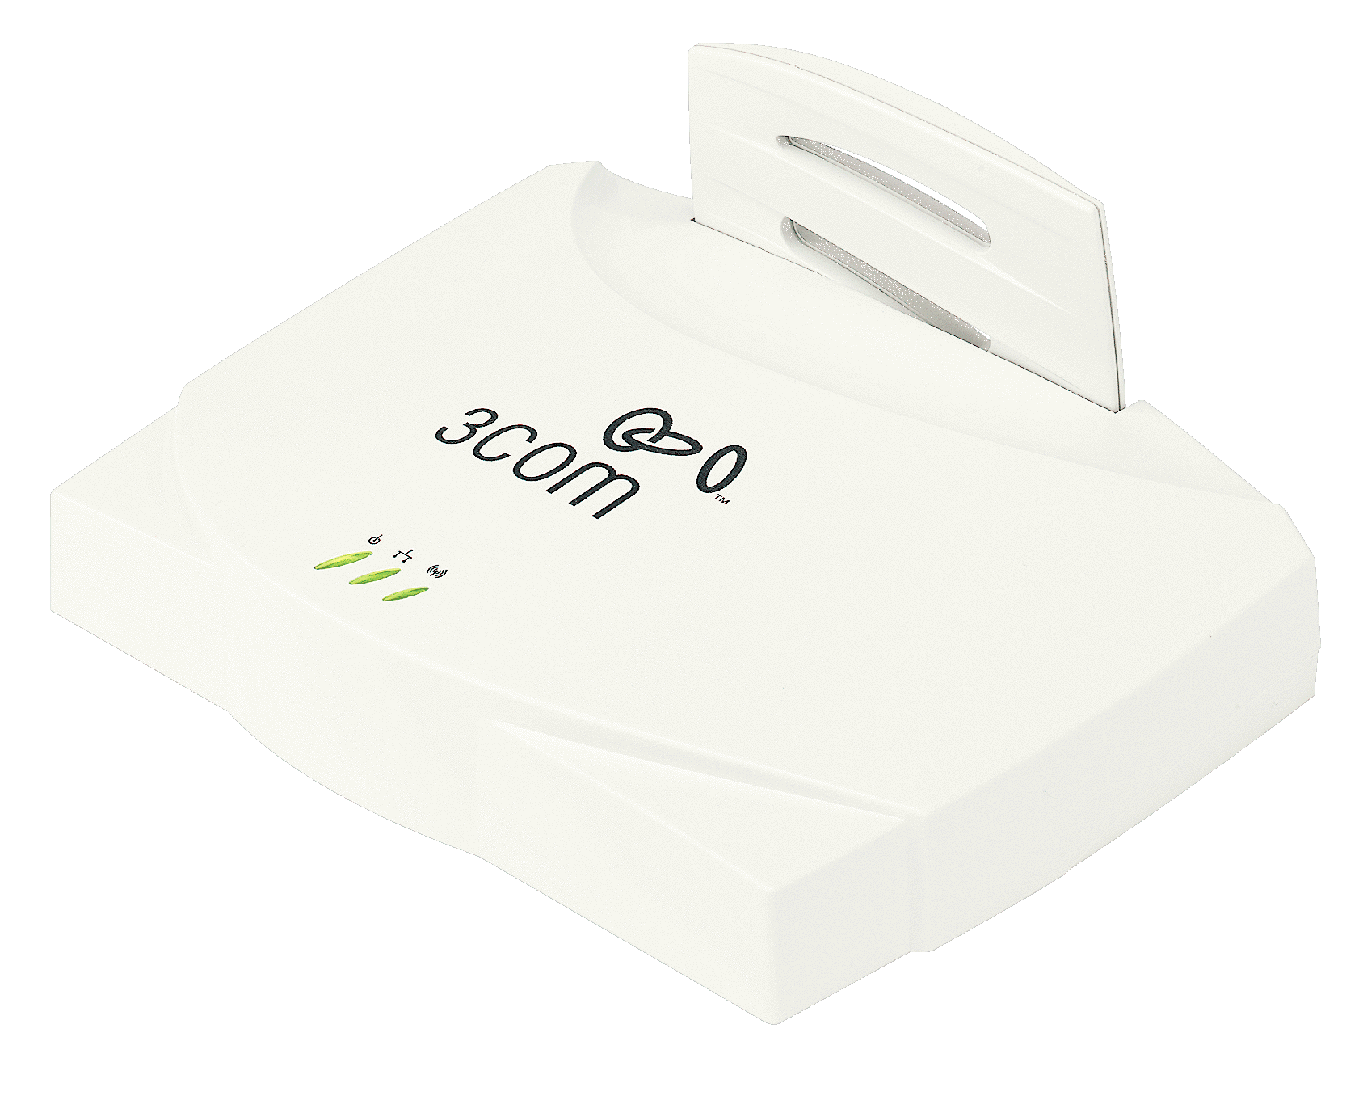
Topologias WLAN:
Ad-hoc vs. Infra-Estruturada
Ponto de Acesso
Cliente
Configuração Ad-hoc
Configuração Infra-Estruturada
Notes:
Wireless LANs can be simple or complex.
At its most basic, two PCs equipped with wireless adapter cards can set up an independent network whenever they are within range of one another. This is called a peer-to-peer wireless network. On-demand peer-to-peer networks such as in this example require no administration or pre-configuration. In this case each client would only have access to the resources of the other client and not to a central server.
Installing an access point (AP) can extend the range of an adhoc network, establishing an infrastructure and effectively doubling the range at which the devices can communicate.
Since the access point is connected to the wired network each client would have access to server resources as well as to other clients.
Each access point can accommodate many clients; the specific number depends on the number and nature of the transmissions involved.

Slide 6
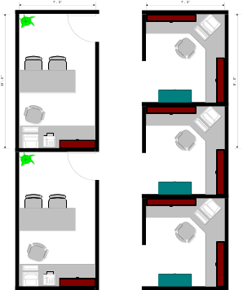
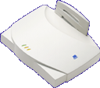

Grande Problema…
Ponto de Acesso
Desempenho depende do produto e configuração de rede
As estações mais próximas normalmente terão um maior ganho em desempenho do que as estações mais afastadas
11
5
2
1
Mbps (velocidade)
Notes:
As with wired LAN systems, actual throughput in wireless LANs is product- and set-up-dependent. Factors that affect throughput include the number of users, propagation factors such as range and multipath, the type of wireless LAN system used, as well as the latency and bottlenecks on the wired portions of the LAN.
The biggest challenge to implementing wireless technologies in LAN applications is, there is an inverse relationship between distance and throughput.
For example, when using a single AP there are “Hot Spots” of throughput. The endpoints closest to the AP will have much higher throughput than the endpoints farthest away, as illustrated above.

Slide 7
O que é o 802.11
As especificações da família WLAN (Wireless LAN) foram desenvolvidas pelo IEEE (Institute of Electrical and Electronic Engineers)
Define padrões para WLAN utilizando as seguintes tecnologias:
  Frequency Hopping Spread Spectrum (FHSS)
  Direct Sequence Spread Spectrum (DSSS)
  Orthogonal Frequency Division Multiplexing (OFDM)
  Infrared (IR)
DSSS, atua na banda de frequência em 2.4 GHz, e é a tecnologia mais empregada.

Slide 8
Tecnologias de Transmissão Sem Fio
A maioria dos produtos opera em bandas de rádio que não requerem licença para uso (unlicensed)
  2.4 GHz é a mais popular
  Disponível em muitas partes do mundo
  Bandas livres - sem custo para uso
A maioria das WLANs utiliza a tecnologia de rádio de espalhamento espectral (spread-spectrum)
  Corresponde às exigências
  Resistente a interferência, segurança
  Métodos:
    Frequency Hopping (FH), Direct Sequence (DS), OFDM
Notes:
Most WLAN systems use spread-spectrum technology, a wideband radio frequency technique developed by the military for use in reliable, secure, mission-critical communications systems. Spread-spectrum is designed to trade off bandwidth efficiency for reliability, integrity, and security.

Slide 9
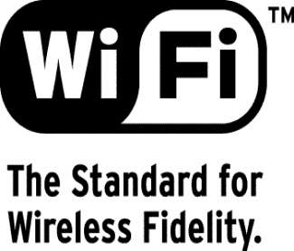
Certificados de Interoperabilidade Wi-Fi
Wireless Ethernet Compatibility Alliance
Mais de 70 membros, incluindo: 3Com, Symbol, Lucent, Cabletron, Aironet, Dell, Intersil, Proxim
Propósito: Garantir interoperabilidade dos produtos 802.11b dos diversos fabricantes
Produtos passam por testes de interoperabilidade para obter certificação Wi-Fi
Objetivo: Wi-Fi = Ethernet para WLAN
Produtos Wi-Fi sãon interoperáveis nas funções básicas:
  Conectividade, Criptografia, e roaming
Notes:
- Goal is to make IEEE 802.11b known as Wi-Fi just as IEE 802.3 is currently known as “Ethernet”
- In order to be eligible for testing, wireless LAN products had to be built on the 802.11b spec, and contain security in the form of 40 bit encryption. Test covered connectivity at 1,2 5.5 and 11 Mbps, performance of mandatory 40-bit encryption, and roaming across Access Points.
- To be Wi-Fi certified a vendor’s station must interoperate with other Wi-Fi certified Access Points / Access Point must interoperate with other Wi-Fi certified stations / product must support station roaming across networks composed of Wi-Fi certified Access points from multiple vendors.
- Many benefits to consumer - No longer risk being locked into single vendor solution. Can use same wireless LAN products across multiple environments, in office, homes, public areas. Standardization will cause volumes to increase driving prices down.

Slide 10
Benefícios
Simplicidade
  Evita custo e confusões de cabeamento
  Fácil e rápida expansão da rede
  Ideal para redes espontâneas/temporárias
Produtividade
  Acesso a e-mails e recursos em qualquer lugar
  Acesso instantâneo a rede de visitantes
Flexibilidade
  Locais de difícil acesso
  Edifícios com paredes sólidas (a base de materiais especiais para isolamento)
  Construções antigas e históricas
  Mobilidade

Slide 11
Parte 2: Aspectos de Projeto de Implementação de WLAN

Slide 12
Tópicos Abordados – Parte 2
Dispositivos
Tipos de Antenas
Roaming e Atribuição de Canais
Segurança
Notes:
This section describes the 11 Mbps Wireless Product by addressing the following:
Name the components of the 3Com’s 11Mbps wireless solution
Identify the primary features and benefits of 3Com’s 11Mbps wireless solution
State product availability and pricing for 3Com’s 11Mbps wireless solution
Identify the benefits of selling the 11Mbps wireless PC card with other 3Com
Wireless solutions
Compare the 3Com 11Mbps wireless solution with AirConnect
This section contains 17 slides.

Slide 13
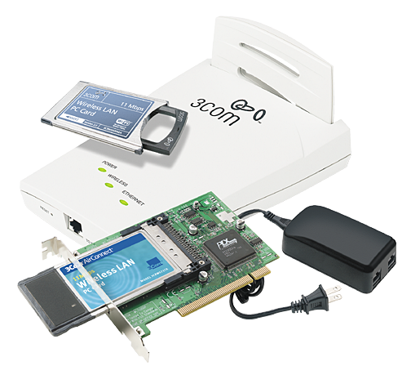
Soluções Wireless LAN 802.11b
11 Mbps Wireless LAN
Access Point 6000
11 Mbps Wireless LAN
PC card
AirConnect 11 Mbps Wireless LAN PCI Card
(desktop connectivity)
Notes:
The Access Point 6000 and PC cards are currently available for the mobility solution. With the PC card Laptops can communicate with Access Points in lobbies, conference rooms and break rooms for collaborative impromptu meetings.
The AirConnect PCI card is the present solution to sell for Desktop communications with the 11 Mbps Wireless Access Point.
In the future 3Com will offer an 11 Mbps Wireless PCI card and USB Module.

Slide 14
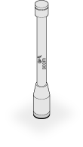
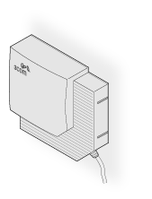
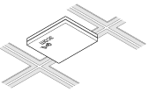

Opções de Antena
Omni-directional Antenna –
3CWE490 – fiberglass design ideal
for use in harsh indoor environments
Directional Panel Antenna –
3CWE498 – ceiling, wall, and corner-mount
flat-panel directional antenna ideal
for use indoors and outdoors
Ceiling Mount Omni-directional Antenna –
3CWE492 – ideal for use in large, open
office areas (such as office spaces
divided into cubicles)
Ceiling Mount Hallway Antenna –
3CWE497 – bi-directional design ideal
for use in long corridors
Notes:
The standard detachable portable antenna supplied with the access point is a multi-purpose antenna suitable for a variety of environments, including office LANs, physical plants and factory floors. If the customer site has special requirements that might be served by different types of antenna, four optional antenna models are available, as shown above.
With a transmission distance up to 300 meters (1,000 ft.), long-range antenna options offer flexibility in determining the area of coverage. Radio transmit power can be configured to meet specific coverage requirements

Slide 15
Roaming
Passagem de um AP para o outro
Meios de oferecer roaming estendido entre subnets:
  IP móvel
  DHCP
O 802.11 não define processo roaming. Apenas menciona critérios para utilização de múltiplos AP’s e reutilização de canais.
Notes:
3Com offers Advanced DHCP support through the Auto Network Connect feature which automatically obtains (release/renew) a new client IP address from the wireless LAN. Auto Network Connect also offers the added feature of automatically configuring a new Extended Service Set ID (ESSID) on the PC Card, based on the ESSID of the nearest AP.
Mobile IP requires software on each router that handles packet forwarding between the router closest to the user and the home router. IP identifies the wireless station point of attachment through its IP address. The AP routes packets according to the location information contained in the IP header. If a wireless station roams across routers to another subnet, the following occurs:
Wireless station changes its point of attachment without changing its IP address causing forthcoming packets to become undeliverable.
Wireless station changes its IP address when it moves to a new network causing it to lose connection.
Mobile IP enables a wireless station to communicate with hosts using its home IP address after changing its point-of-attachment to the network. Mobile IP is like giving an individual a local post office forwarding address when leaving home for an extended period. When mail arrives for the individual home address, it is forwarded by the local post office to the current care-of-address. This method requires the local post office to be notified of the individual current address. While this example gives the general concept of Mobile IP, it does not exactly represent the implementation of Mobile IP used.

Slide 16
Roaming
O uso de AP’s pode resultar em uma área de acesso ilimitada
Suporte para múltiplas redes RF existentes em uma mesma área física
Parte do processo de re-associação
  Canal RF pode mudar durante roaming
Canais múltiplos permitem maior tamanho de banda
Notes:
802.11b compliant products provide the above functionality to facilitate roaming.
The 3Com 11 Mbps Wireless Access Point 6000 Clear Channel Select feature automatically scans the spectrum to select a channel not in use by other access points. If no channel is entirely clear, the clearest of three main channels is selected.
APs working together in an infrastructure WLAN define an Extended Service Set (ESS), and all APs within the ESS must share the same ESSID. The ESSID is either an industry-standard value or user-defined. The ESS consists of a series of overlapping BSSs (each containing an AP) connected together by means of a Distribution System (DS). Although the DS could be any type of network, it is almost invariably an Ethernet LAN. An ESS is a Layer 2 construct and appears as a single subnet to higher layer protocols (e.g., IP).

Slide 17
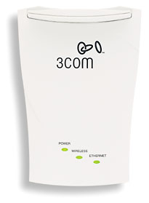
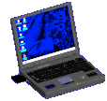
Conceitos de Roaming
Roams entre APs
Quando o usuário móvel se move de um AP para o outro, o cartão WLAN NIC automaticamente se re-associará com o novo AP afim de manter o desempenho.
Notes:
The ability of stations to move seamlessly among a cluster of APs is called roaming. APs hand off the station from one to another in a way that is invisible to the station, ensuring unbroken connectivity as long as roaming users stay in range of at least one AP.
Roaming can occur when:
An unassociated wireless station attempts to associate or reassociate with an available AP
The supported data rate changes or the wireless station finds a better transmit rate with another AP
The signal quality of a potential AP exceeds that of the current AP
The ratio of good-transmitted packets to attempted-transmitted packets falls below a threshold.
When the wireless station begins to lose the signal as it roams away from its associated AP, it continues to scan to find another AP. As wireless stations switch APs, the AP updates its association table.
Note: 3Com offers Advanced DHCP support through the Auto Network Connect feature to automatically assign a new IP address to the client. Auto Network Connect also automatically configures a new ESSID on the PC Card based on the ESSID of the nearest access point.

Slide 18

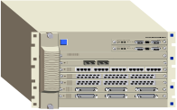

Roaming Estendido
…across AP’s and router boundaries using DHCP
SuperStack® 3
Switches
SuperStack 3
Switch
Switch 4005
Internet
SuperStack 3
Switches
In Conference Room
SuperStack 3
Switch
Extended
Roaming
In Lobby
Desktop
Basic Roaming
Building 1
Building 2
Notes:
Dynamic Host Control Protocol (DHCP) roaming will be the most common method for roaming across boundaries. A wireless station receives a new IP address after boot up, suspend/resume or running the windows winipcfg utility.
3Com offers Advanced DHCP support through the Auto Network Connect feature to automatically assign a new IP address to the client. Auto Network Connect also automatically configures a new ESSID on the PC Card based on the ESSID of the nearest AP. The Auto Network Connect feature allows you to roam across router boundaries without increasing traffic on wired net or adding latency to network sessions.

Slide 19
Roaming – Reutilizando canais para estender área de cobertura
1
1
6
11
11
1
AP’s podem ser programados para operar em diferentes canais e esses podem ser reutilizados para prover uma maior área de cobertura.
Notes:
Roaming allows frequency reuse and unlimited coverage areas.
The 3Com 11 Mbps Wireless Access Point 6000 Clear Channel Select feature automatically scans the spectrum to select a channel not in use by other APs. If no channel is entirely clear, the clearest of three main channels
(1, 6 & 11) is selected. Channels 1, 6 & 11 are recommended as they do not overlap and will have the least interference.

Slide 20
Ferramentas de Apoio
Ferramentas de “Site Survey”
  Ajuda a determinar a melhor localização de cada AP
  Ajuda no cálculo do número de AP’s necessários para cobrir uma determinada área e tamanho de banda
Notes:
Sixty-second setup -No installation required for the AP, simply plug in the power source and you are seen by the clients. Clients automatically assigned a valid IP address.
Power over Ethernet Cabling -Using the supplied Power Brick, low-voltage DC power can be supplied to the Access Point 6000 over a standard 10BASE-T Ethernet connection, eliminating the need to run new AC power circuits.
Automatic IP Address Assignment -Wireless clients are automatically assigned a valid IP address. If a user cannot make a network connection, the system automatically performs an IP release/ renew to obtain a valid IP address. This feature can be disabled if preferred.
Automatic Naming of Access Points -Up to 100 default names can automatically be assigned to Access Points, making it unnecessary to keep track of each Access Point’s IP address. Access Points can be renamed as desired.
Site Survey Utility - 3Com’s Site Survey utility helps you determine the best location for each Access Point and calculate the number of Access Points needed for sufficient bandwidth and coverage. Using a notebook with a wireless LAN PC Card, you can log signal strength and transmission statistics from the locations that need network access.
Network Assistant CD-ROM - 3Com’s unique tutorial CD-ROM is a boon to small businesses that want to set up a wireless network without employing an IT specialist.

Slide 21
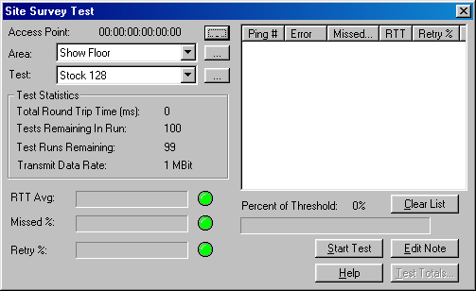
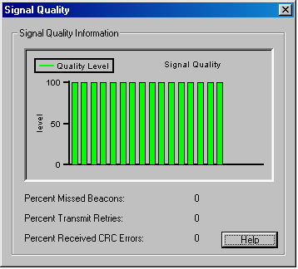
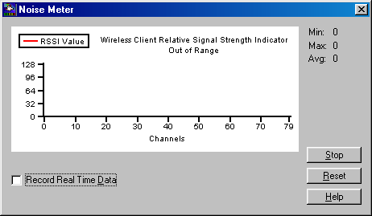
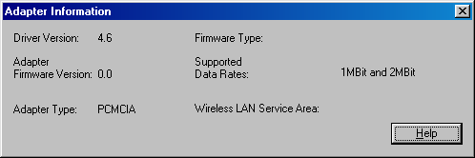
Informações obtidas pro Site Survey

Slide 22
Confiabilidade de Acesso
Taxas dinâmicas
  Access Points (AP) suportam taxas 11, 5.5,
  2 e 1 Mbps
  A taxa de dados mais apropriada é determinada automaticamente por:
    Força do sinal
    Número de clientes na rede
DHCP suportado sobre o AP
  Garantia de que o usuário poderá se mover para outros AP’s sem interromper operação ou perder dados
Notes:
Dynamic Rate Shifting -Access points dynamically support 11, 5.5, 2, and 1 Mbps.The proper data rate is determined automatically, based on signal strength and the number of wireless clients in use. Guarantees connectivity even at long range or in noisy environments.
DHCP Support-An embedded DHCP server on each Access Point assigns leased IP addresses automatically, ensuring that users can roam between Access Points without interrupting operations or losing data..
Seamless Roaming
The Dynamic Host Configuration Protocol (DHCP) can be used to obtain a leased IP address from the DHCP server embedded on each Access Point. This allows notebook users to roam the office seamlessly, automatically obtaining new IP addresses as they enter the coverage area for a different Access Point.
XJACK® Antenna for Mobile Computers- PC Cards feature 3Com’s award-winning XJACK antenna. It retracts to minimize notebook size and protect the antenna while in transit, and extends to provide excellent reception wherever the user needs it.

Slide 23

Segurança
Criptografia
  WEP, 40-bit ou 104-bit
  O WEP é interoperável com os produtos
  Wi-Fi™
Chaves Dinâmicas
  Criptografia utilizando chaves de sessões de 128-bit
    Uma única chave é automaticamente gerada entre AP e cliente wireless para cada sessão
Autenticação do Usuário
  Como mecanismo adicional de segurança, é possível requerer que todos os usuários executem loggin para cada sessão
Notes:
Dynamic Security link - 128-bit encryption includes both 128-bit shared key and 128-bit session key encryption. With session key encryption, Dynamic Security link automatically generates a unique key between the Access Point 6000 and wireless client for each session.
Access Control - You can control user access by specifying that only clients programmed with the WAN Service Area ID of a given Access Point can connect to that Access Point.
Note: There is a compatibility restriction with regard to 128-bit encryption. It will not be possible to use 128-bit shared-key encryption between the 11Mbps Wireless AP and an AirConnect NIC or visa versa.

Slide 24
Exemplos de Aplicações utilizando Tecnologias de Rede Sem Fio

Slide 25
Aplicações
Interligação computadores sem fio
Interligação entre LAN’s
Internet Building
Backbone Wireless
Voz sob IP usando Wireless

Slide 26
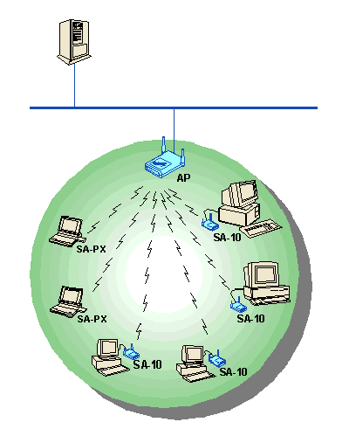
Interligação Computadores Sem Fio
Solução INDOOR

Slide 27
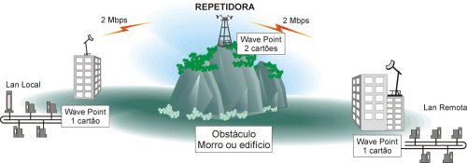
Interligação de LAN’s
Link com Repetidora (Solução OUTDOOR)

Slide 28
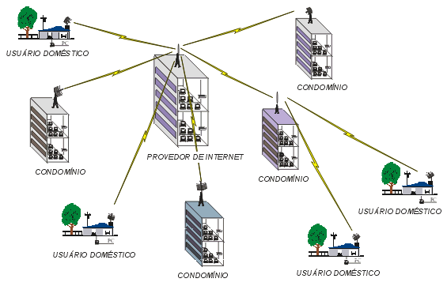
Internet Building
Provedor Internet (Solução OUTDOOR)

Slide 29
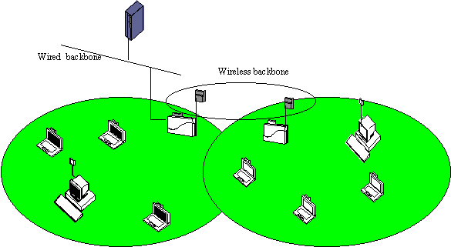
Backbone Wireless
Backbone Wireless

Slide 30
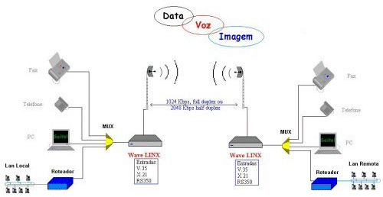
Voz sobre IP Utilizando Rede Sem Fio
Voz sob IP usando redes sem fio

Slide 31
Solução Indoor

Slide 32
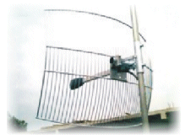
Solução Outdoor
Acessórios p/ Solução Outdoor
Parabólica 24 dBi

Slide 33
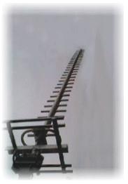
Solução Outdoor
Yagi 17 dBi

Slide 34
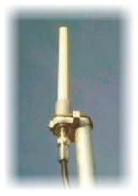
Solução Outdoor
Omni-direcional 8 dBi

Slide 35
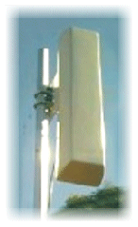
Solução Outdoor
Painel Setorial - ângulo de 90 graus 12 dBi

Slide 36
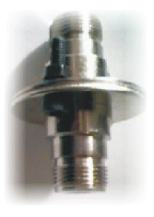
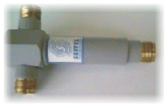
Solução Outdoor
Divisor de Potência Centelhador

Slide 37

Solução Outdoor
Amplificador de Potência (para distâncias >10 Km)

Slide 38
Especificações técnicas
Norma IEE 802.11
Freqüência nominal 2,4 GHz
Taxa de transmissão 2 e 10 Mbps
Potência media 50mW

Slide 39
Especificações técnicas
Alcance na solução Outdoor com visada direta: 10Km s/amplificador e até 50Km com amplificador
Solução Indoor alcance até 400m

Slide 40
Legislação Vigente
Portaria número 814 do Ministério das Comunicações de 12/07/96
Freqüência s/ licenciamento faixas:
    902 - 928 MHz;
    2,4 - 2,4835 GHz;
    5,725 - 5,850 GHz.
Com uso de espalhamento de Espectro.
Potência máxima de saída 1 W

Slide 41
Wireless LAN HotSpots: Aplicações e Tecnologias

Slide 42
Introdução
O que é um Hotspot wireless?
  Uma área pública oferecendo conectivadade Wi-Fi em alta-velocidade
O que é uma rede Hotspot Wireless?
  Um sistema unificado de hardware e centrais de operações para prove qualidade de acesso
  Quem utiliza uma rede Hotspot?
  Alguém que necessita acessar a Internet enquanto está fora de casa ou escritório
Onde os hotspot são encontrados?
  Café, shopping, hotéis, restaurantes…

Slide 43
Características chave
Acesso aberto
Roaming
AAA – Authentication, Authorization, Accounting
Baixo custo

Slide 44
Estrutura da Rede
Provedor localização de Hotspot
  Qualquer organização que ofereça taxas de acesso a Internet wireless de uma localização física
Operador de Hotspot
  Instala e gerencia equipamentos do Hotspot
  Controle de contas de usuários
Provedor AAA
  Gerencia a rede e operações de contabilização

Slide 45
Componentes e Operadores
Hotspot
ISP Local
Usuário
Ponto de Acesso
Controlador de Acesso
Conexão
Broadband
Internet
Private Virtual Network
Provedor AAA
Controlador de Acesso
  Gerencia contas de usuário
  Interface com RADIUS
  Ponte de comunicação com serviços Internet
RADIUS
Server
Settlement

Slide 46
Exemplo – Infra-estrutura
Public Facility
Internet Services
Access point
Access point

Slide 47
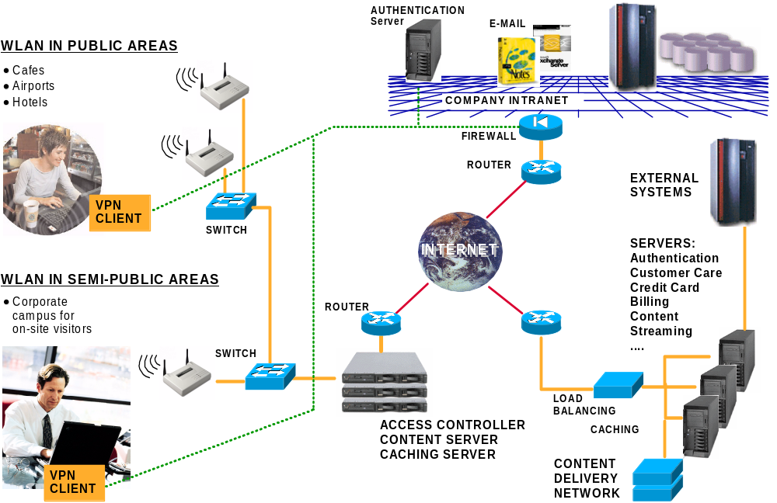
Exemplo de Conectividade Wireless Broadband

Slide 48
Benefícios
Benefícios
  Acesso Internet em Alta-velocidade (desempenho de 5 a 6 Mbps)
  Ter conectividade em muitos lugares
  Conveniência – sem espera ou hookups
  Freedom of movement
Custo
  Cartão de rede $150
  Serviço: $20 por 120 minutos (MobileStar)
  Taxas adicionais ($10 por dia) de alguns hotspots
Até quando os benefícios valem os custos?

Slide 49
Tecnologias e Padrões
Wireless LAN 802.11b
  Taxas de dados de 11 Mbps
  Transmissão de rádio de 2.4 GHz
  Direct sequence spread spectrum
  Certificação Wi-Fi WECA
WECA Wireless ISP Roaming (WISPr)
  Provedor de Serviços
  Custo usuário final semelhante ao conexões dial-up
  Nível de desempenho “Broadband”
  Acesso universal e cliente Smart
802.11
Pontos de acessos
Usuário
Hotspots
WISPr
ISPs
AAA

